Slide 1



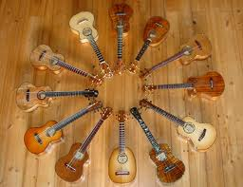


The UKULELE

Slide 2
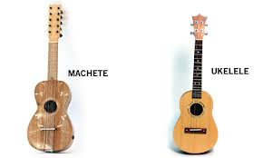
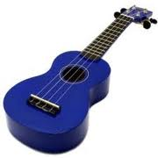
History
The ukulele was first made in 1879, but it didn’t become popular until the 1960s.
It is based on the machete, a small, guitar-like instrument introduced by Portuguese and Spanish immigrants.

Slide 3

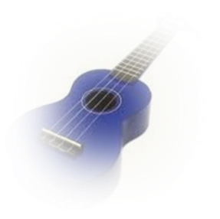
About the Ukulele
The ukulele is a Hawaiian instrument that is part of the guitar family of stringed instruments.
Only 3 companies worldwide manufacture ukuleles.

Slide 4
Ukuleles are generally made of wood, but cheaper ukuleles can be made from plastic. Some expensive ukuleles, which may cost thousands, are made from Acacia koa, a Hawaiian wood.
Ukuleles generally have a similar shape to the guitar, except they are smaller. They usually have 4 strings.

Slide 5
There are 4 types of ukulele...
The ukulele is played with the thumb and fingertips, and has four strings.
The ukulele comes in four sizes, soprano, concert, tenor and baritone.
Each size has a different sounds and volume.

Slide 6
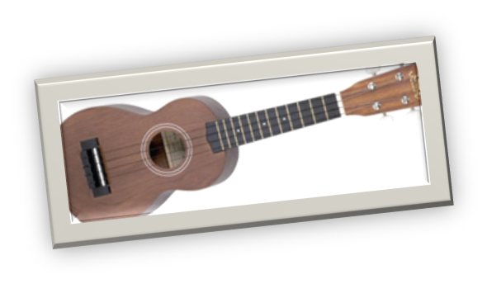

Soprano
The soprano ukulele is 21 inches long.
It is the most common and standard type of ukulele.
It’s the smallest ukulele.
It was the first size of ukulele, made in the early 1900’s.

Slide 7
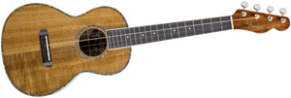
Tenor
The tenor ukulele is just a little bit bigger than the concert ukulele. It has a deeper sound.
The tenor ukulele is just about 26 ¼ inches long.

Slide 8
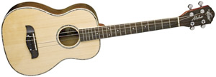
Baritone
The baritone ukulele is the biggest of the ukuleles.
It gives a deeper sound.
It is around 30 inches long

Slide 9
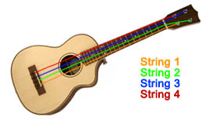
Tuning the Ukulele
The ukulele has 4 nylon strings.
These are tuned to the notes G, C, E and A.

Slide 10
Use of the Ukulele in Songs
The ukulele is a common instrument used in songs
e.g I’m Yours, by Jason Mraz...
... Hey, Soul Sister by Train...
...and Classy Girls by the Lumineers.
(In this song, the ukulele is plucked)

Slide 11

Thanks for Watching!

